Slide 1

Gamma Knife

Slide 2
What is it?
Co-60 sources
~30 Ci each
Collimator focused

Slide 3
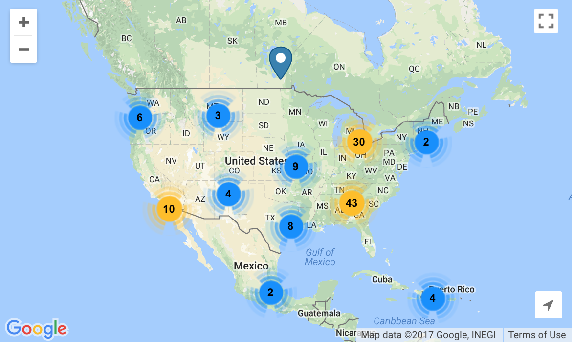
History
Developed by Lars Leksell in Stockholm
Treat small tumors in brain
Useful in other cases (AVM)
Notes:
Trigeminal neuralgia is a chronic pain condition that causes intense pain from any stimulation of the face
arterio-venous malformation

Slide 4
Comparison with LINAC
LINAC
Gamma Knife
Larger treatment volumes
Repairs/servicing required more often
Estimated life around 10 years
Smaller treatment volumes
Higher acquisition costs
Lower operating costs
20 year service life
Replace sources 5-7 years
Notes:
More precise

Slide 5
More comparison
LINAC
Gamma Knife
Fractionated doses
More dose leakage
Source/beam moves
Brain only!
Single-day treatment
Notes:
2-3 times more dose to the healthy brain with LINAC

Slide 6
Advantages!
Out of 835 treated:
2.2% had neurological event or death
5/835 had temporary neurological deficits
SRS alone as “effective” as WBRT+SRS
Higher relapse rate
Notes:
Chin, L. S., Lazio, B. E., Biggins, T., & Amin, P. (2000). Acute complications following gamma knife radiosurgery are rare. Surgical Neurology, 53(5), 498–502. https://doi.org/10.1016/S0090-3019(00)00219-6
Study looked at complications within 7 days after surgery

Slide 7

Surgery planning
Sphere packing problem!
Optimal (non-overlapping) is $\frac{π}{3√2}$

Slide 8
Treatment
pituitary adenomas
schwannoma
vascular malformations
menigioma
melanoma
glioma

Slide 9
Vascular Malformations
Comparable treatments
Lower dose from LINAC (16 vs 20 Gy)
Equivalent effectiveness (72% vs 60% success, but not statistically significant)

Slide 10
Neural disorder treatment
Trigeminal Neuralgia 10-year follow up study: bothersome in <2% of patients
Epilepsy seizure cessation in epilepsy patients treated for AVT, biochemical changes in rats
OCD ~50% of patients responded to gamma knife capsulotomy
Notes:
The cells don’t die though!

Slide 11
Trigeminal Neuralgia
Notes:
Treatment effectiveness from 75 Gy GKS vs time. One third of these patients had already had 1-3 physical surgeries. Response duration was better if you had never had physical surgery. Other experiment showed 26/52 patients experienced pain relief (not TN)
Found 2 studies confirming
Dhople, A. A., Adams, J. R., Maggio, W. W., Naqvi, S. A., Regine, W. F., & Kwok, Y. (2009). Long-term outcomes of Gamma Knife radiosurgery for classic trigeminal neuralgia: implications of treatment and critical review of the literature. Journal of Neurosurgery, 111(2), 351–358. https://doi.org/10.3171/2009.2.JNS08977

Slide 12
Parkinson Disease
Japanese study
72 treated, 53 completed follow-up
43 evaluated as “excellent or good results”
Notes:
Ohye, C., Higuchi, Y., Shibazaki, T., Hashimoto, T., Koyama, T., Hirai, T., … Yamashiro, K. (2012). Gamma Knife Thalamotomy for Parkinson Disease and Essential Tremor. Neurosurgery, 70(3), 526–536. https://doi.org/10.1227/NEU.0b013e3182350893

Slide 13
Epilepsy
AVM patients with epilepsy noted having lower seizure rates post GK
Amygdalohippocampectomy
6/7 patients seizure-free at 61 months
Notes:
Régis, J., Bartolomei, F., Rey, M., Genton, P., Dravet, C., Semah, F., … Peragut, J.-C. C. (1999). Gamma knife surgery for mesial temporal lobe epilepsy. Epilepsia, 40(11), 1551–1556. https://doi.org/10.1111/j.0013-9580.2005.53904.x

Slide 14
Obsessive Compulsive Disorder
16 patients, half given gamma ventral capsulotomy
5/8 in experimental group responded to treatment at ~5 years
4 of control group got treatment later, 2/4 effective
Notes:
WHAT EVEN IS THIS
Lopes, A. C., Greenberg, B. D., Canteras, M. M., Batistuzzo, M. C., Hoexter, M. Q., Gentil, A. F., … Miguel, E. C. (2014). Gamma Ventral Capsulotomy for Obsessive-Compulsive Disorder. JAMA Psychiatry, 71(9), 1066. https://doi.org/10.1001/jamapsychiatry.2014.1193

Slide 15
Functional effects?
Experiment with rats
“Differential effects were first observed between glutamate decarboxylase and choline acetyltransferase, and secondarily between excitatory amino acids (AAs) and non-excitatory AAs, particularly gamma-aminobutyric acid.”
Notes:
Régis, J., Kerkerian-Legoff, L., Rey, M., Vial, M., Porcheron, D., Nieoullon, A., & Peragut, J. C. (1996). First biochemical evidence of differential functional effects following Gamma Knife surgery. Stereotactic and Functional Neurosurgery, 66 Suppl 1, 29–38. Retrieved from http://www.ncbi.nlm.nih.gov/pubmed/9032842

Slide 16
Questions

